Slide 2
Digital technology
TK1104-1 22H
Lecturer: Toktam Ramezanifarkhani
Toktam.Ramezanifarkhani@kristiania.no
Toktamr@ifi.uio.no

Slide 3
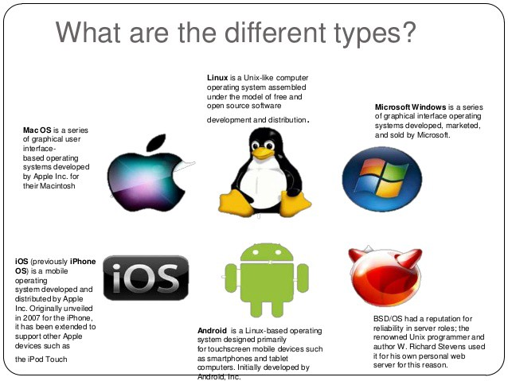
Operating System

Slide 4
Today
Focus on getting an overview
Learn the concepts used in literature and documentation
Exercises
Theory and concepts, as well as some history
Learn command-line interface on your own OS, how to maneuver and how to do simple tasks in command-line
Other things you need; opening archive files and installing software

Slide 5
Booting
5/64
Main memory (DRAM, SRAM) is volatile
Turn off the power, lose the contents
Turn on the power, memory is empty
We need the OS to be loaded and running in memory to load and run programs
If you turn your computer on, how do we get the OS loaded into memory and running?
We need a process – booting
The boot process (or portions of it) are stored in ROM (non-volatile memory)

Slide 6
The Boot & Initialization Process
6/64
CPU initializes itself (registers, control signals)
BIOS performs power on self test
Disk controllers tested
BIOS determines where the OS is stored
Boot loader runs to load OS (if multiple OSs available, user might be able to select)
OS kernel loaded and initialized
Kernel often stored on hard disk (possibly also available on optical disk, flash drive or over network)
OS runs initialization scripts
Establish runlevel (Linux levels from 0 to 6, windows has safe mode, safe mode with network, user mode, etc)
OS running, computer ready for user

Slide 7
Start-up (bootstrapping)
Memory (ROM)
BIOS: performs power on self test
Disk
Memory (RAM)
1 Get bootstrap
POST
(BIOS/UEFI)
Bootstrap
2. Get Boot-loader
3. Get OS
Bootstrap
Loader
4. Initialize hardware
Loader
5. Create user interface
6. Start fixed programs (initialization scripts)
OS
OS

Slide 8
Boot Procedure
8/64
You press the power button on your laptop/desktop.
The CPU starts up, needs some instructions to work on
the main memory is empty at this stage,
CPU defers to load instructions from the firmware chip on the motherboard and begins executing instructions.
The firmware code, BIOS, does a Power On Self Test (POST),
initializes the remaining hardware,
Detects and checks the connected peripherals (mouse, keyboard)
You might remember it as a 'beep' that desktops used to make after POST is successful.
Finally, the firmware code cycles through all storage devices and looks for a boot-loader (usually located in first sector of a disk).
If the boot-loader is found, then the firmware hands over control of the computer to it.
Notes:
You might not need UEFI
Though all modern computers come equipped with UEFI by default, some reasons why you might choose BIOS over UEFI are:
If you're beginner and don't care about messing with any type of firmware, BIOS is for you.
If you have < 2 TB per hard disk or partition, you can go with BIOS.
BIOS allows running multiple operating systems without changing any settings This can be a security issue from a modern standpoint, but hey, no hassles for the user.
BIOS provides system information to the operating system. So if your OS runs in 16 bit mode, it does not require writing code for interacting with hardware. It can directly use methods provided by BIOS. Else if the OS switches over to 32bit or 64bit mode, then it needs to provide its own subroutines for interacting with hardware.
If you are someone who prefers a keyboard and text based UI over navigation with a mouse and GUI, then BIOS is for you.
UEFI takes these limitations into account and provides a Legacy mode. In it you can run everything as if you had a BIOS firmware. But keep in mind that Intel has announced that it won't support traditional BIOS from 2020.

Slide 9
Boot Procedure
9/64
the boot-loader is loaded, its job is to load the rest of the operating system (GRUB in unix-like os)
Boot-loader is usually available in the first sector of a disk, which is 512 bytes.
The boot-loader then loads the kernel into memory.
Unix-like operating systems then run the init process (the master process, from which other processes are forked/executed) and finally initialize the run-levels.
In Windows, wininit.exe is loaded along with some other processes like services.exe for service control, lsass.exe for local security and authority (similar to run-levels) and lsm.exe for local session management.
Then some other drivers are initialized, the Graphical User Inferface (GUI) is loaded and you are presented with the login screen.
Notes:
You might not need UEFI
Though all modern computers come equipped with UEFI by default, some reasons why you might choose BIOS over UEFI are:
If you're beginner and don't care about messing with any type of firmware, BIOS is for you.
If you have < 2 TB per hard disk or partition, you can go with BIOS.
BIOS allows running multiple operating systems without changing any settings This can be a security issue from a modern standpoint, but hey, no hassles for the user.
BIOS provides system information to the operating system. So if your OS runs in 16 bit mode, it does not require writing code for interacting with hardware. It can directly use methods provided by BIOS. Else if the OS switches over to 32bit or 64bit mode, then it needs to provide its own subroutines for interacting with hardware.
If you are someone who prefers a keyboard and text based UI over navigation with a mouse and GUI, then BIOS is for you.
UEFI takes these limitations into account and provides a Legacy mode. In it you can run everything as if you had a BIOS firmware. But keep in mind that Intel has announced that it won't support traditional BIOS from 2020.

Slide 10
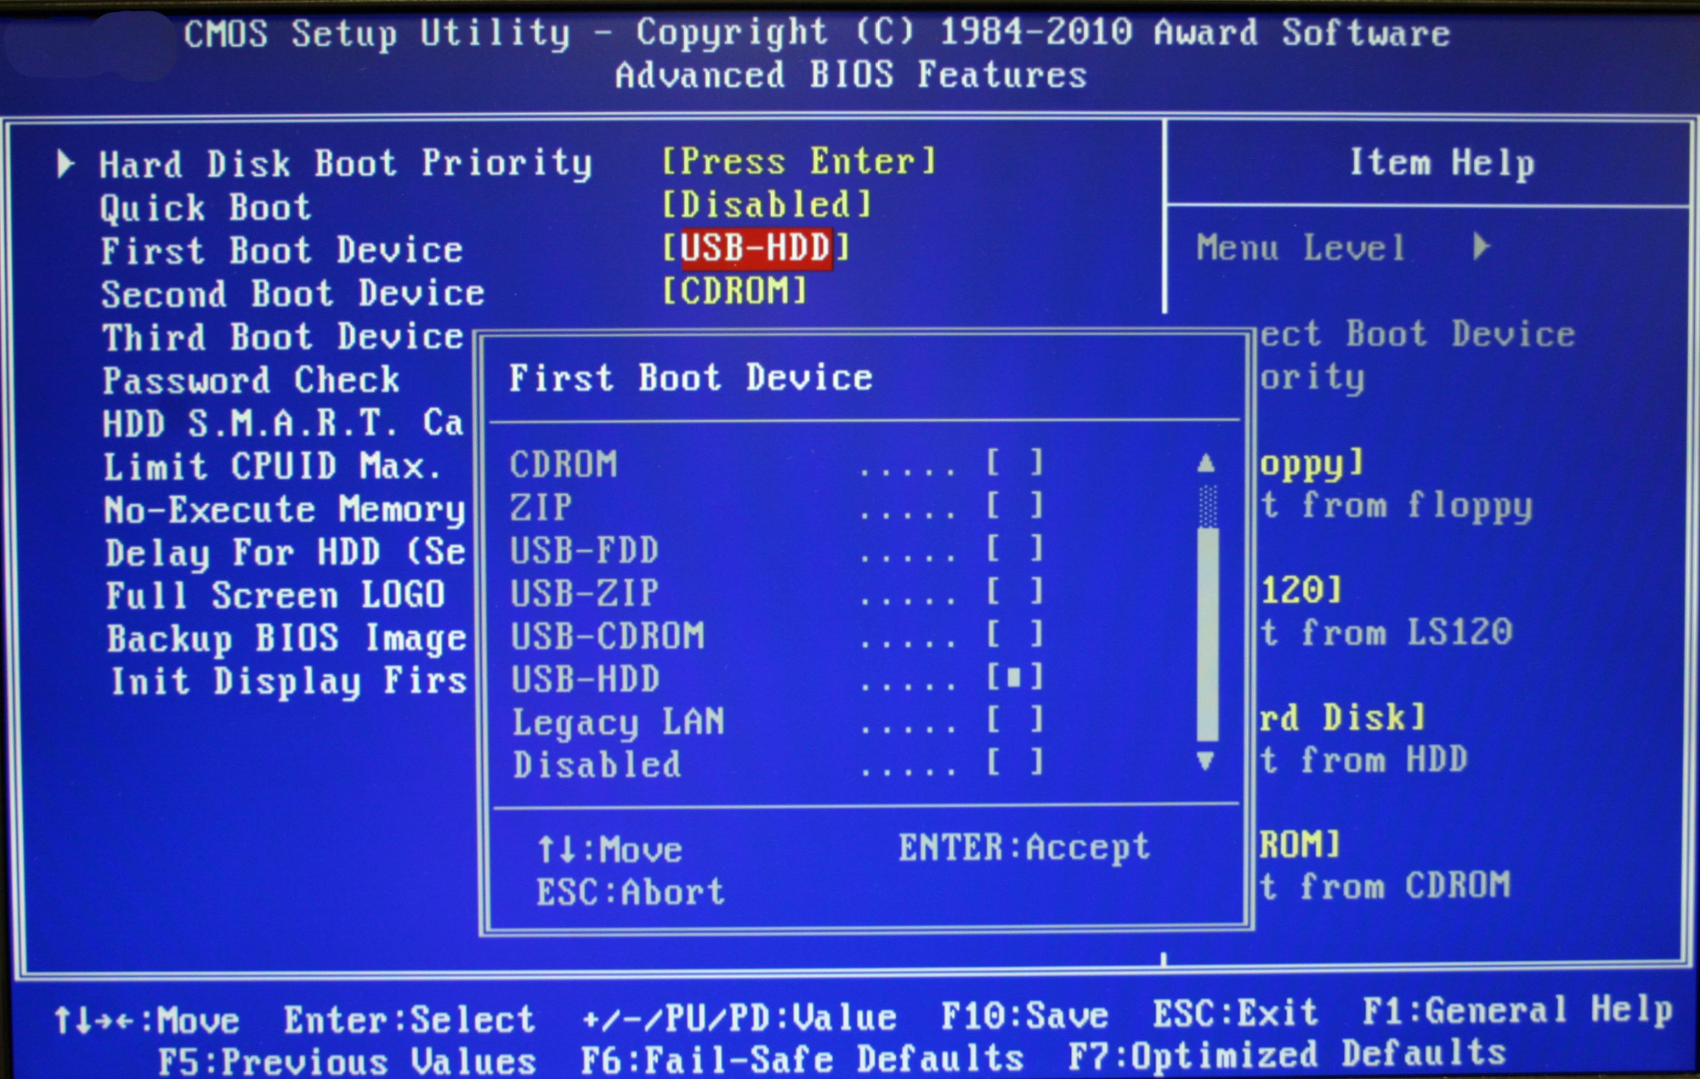
BIOS
10/64
BIOS stands for Basic Input/Output System, the firmware we talked about in the boot procedure.
It is stored on an EPROM (Erasable Programmable Read-Only Memory),
allowing the manufacturer to push out updates easily.
It provides many helper functions that allow reading boot sectors of attached storage and printing things on screen.
You can access BIOS during the initial phases of the boot procedure by pressing del, F2 or F10.

Slide 11
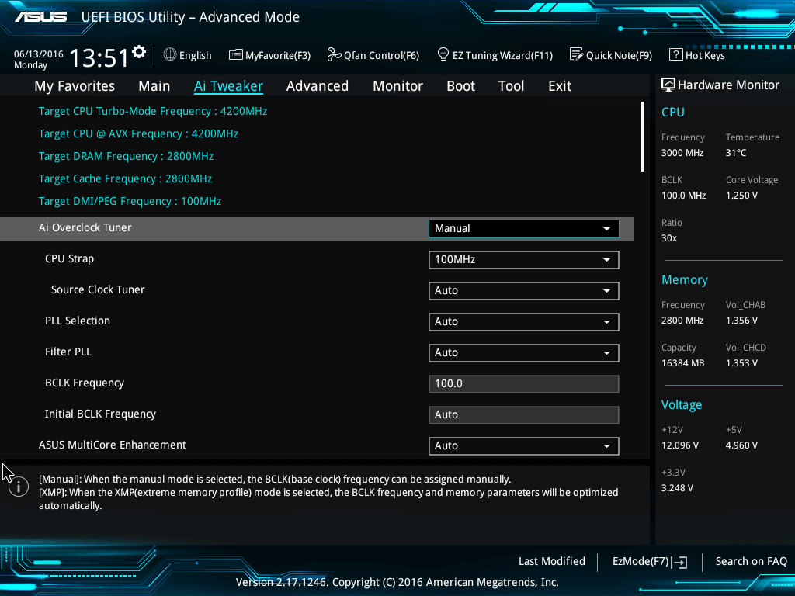
UEFI (Unified Extensible Firmware Interface)
11/64
UEFI does the same job as a BIOS, but with one basic difference:
it stores all data about initialization and startup in an .efi file, instead of storing it on the firmware.
This .efi file is stored on a special partition called EFI System Partition (ESP) on the hard disk (not ROM). This ESP partition also contains the bootloader

Slide 12
UEFI was designed to overcome many limitations of the old BIOS
12/64
UEFI provides faster boot time.
UEFI has discrete driver support, while BIOS has drive support stored in its ROM, so updating BIOS firmware is a bit difficult.
UEFI offers security like "Secure Boot", which prevents the computer from booting from unauthorized/unsigned applications. This helps in preventing rootkits, but also hampers dual-booting, as it treats other OS as unsigned applications. Currently, only Windows and Ubuntu are signed OS.
UEFI runs in 32bit or 64bit mode, whereas BIOS runs in 16bit mode. So UEFI is able to provide a GUI (navigation with mouse) as opposed to BIOS which allows navigation only using the keyboard.

Slide 13
13/64
Standard runlevels
ID | Name | Description
0 | Off | Turns off the device.
1 | Single user mode | Does not configure network interfaces or start daemons.^{[a]}
6 | Reboot | Reboots the device.
Linux Standard Base (LSB)
ID | Name | Description
0 | Off | Turns off the device.
1 | Single-user mode | Mode for administrative tasks.^{[2][b]}
2 | Multi-user mode | Does not configure network interfaces and does not export networks services.^{[c]}
3 | Multi-user mode with networking | Starts the system normally.^{[1]}
4 | Not used/user-definable | For special purposes.
5 | Full mode | Same as runlevel 3 + display manager.
6 | Reboot | Reboots the device.

Slide 14
What is an Operating System? (1)
14/64
The OS is a program
Permit easy access, control hardware, communicate between user and software, user and hardware, software and hardware, maintain the computer system (hardware and software)
Users can access the OS via GUI and command line
Kernel
Always resident in memory
Responsible for primary OS tasks (process management, memory management, resource management, protection, security)
Device drivers
Program interfaces between OS and peripheral devices
Shell
User interface
Utility programs
Add on programs to further manage and fine-tune your system (anti-viral programs, disk utilities, screen savers, etc)

Slide 15
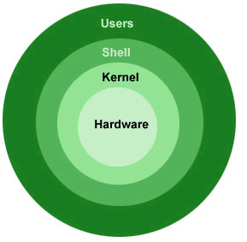
What is an operating system? (2)
The operating system is software that lies between the user / programmer and the hardware
A computer platform is a system that consists of a hardware device and an operating system that an application, program or process runs upon.

Slide 16
What is an operating system (OS)? (3)
“An operating system (OS) is a collection of programs that acts as an intermediary between the hardware and its user(s), providing a high-level interface to low level hardware resources, such as the CPU, memory, and I/O devices. The operating system provides various facilities and services that make the use of the hardware convenient, efficient, and safe” Lazowska, E. D.: Contemporary Issues in Operating Systems , in: Encyclopedia of Computer Science, Ralston, A., Reilly, E. D. (Editors), IEEE Press, 1993, pp.980
It is an extended/abstract machine (top-down view))
Hides the "dirty" details in HW
Offers the user and the programmer a virtual machine that is easier to program / use
It is a resource manager (bottom-up view))
Each program gets time on the resource
Each program has space on the resources (CPU, Memory,…).
user
application
OS
hardware

Slide 17
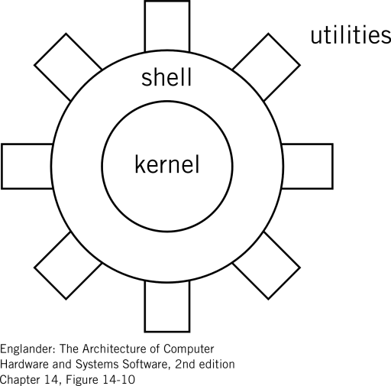
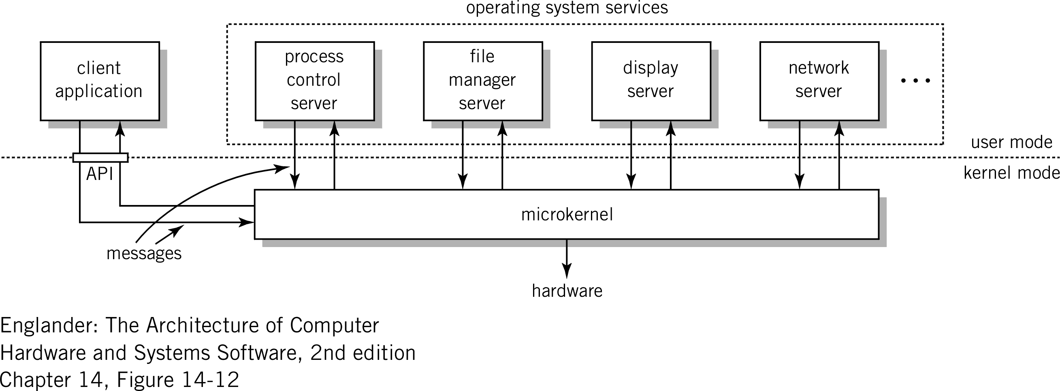
OS Organization
Several possible approaches, no standard.
Monolithic kernel (“the big mess”):
Written as a collection of functions linked together into one object.
Usually effective (no boundaries crossed in the core)
Large, complex, crashes easily
UNIX, Linux, Windows NT, OSX (in practice,
but MACH in the beginning))
Microkernel
Core with minimal functionality (manage interrupt, memory, processor)
Other services are implemented as server processes in user mode according to a client-server model.
Lots of message exchange (inefficient)
small, modular, expandable, portable,…
MACH, L4, Chorus, AmigaOS, Minix, K42
A monolithic kernel is an operating system architecture where the entire operating system is working in kernel space.
Hybrid Kernel and Exokernel
Notes:
https://slideplayer.com/slide/5146573/

Slide 18
Features of operating systems
User interface (GUI, shell!)
Application run
Provides API (Application Programming Interface)
In contrast to a user interface, which connects a computer to a person, an application programming interface connects computers or pieces of software to each other.
Offers SPI (System Programming Interface)
Service provider interface (SPI) is an API intended to be implemented or extended by a third party. A service is a well-known set of interfaces and (usually abstract) classes.
Resource management
Processes, memory, external storage, I/O devices
Hardware management
Drivers!
Network management
Safety
Most often closely linked to the file system
Not all computer applications need an OS

Slide 19
Analysis of OS «core»
Applications
Software
File
Admin
Process, Thread &
Resource Admin
OS «core»
Memory
Admin
Equipment
Admin
Hardware
Processor (s)
Memory/RAM
Equipment

Slide 20
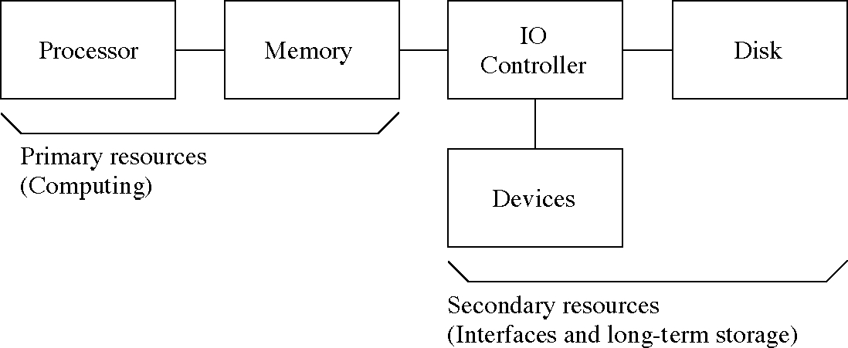
Operating system - main functions
Starting up the machine
Internal treatment
GUI, "auditing", security, error handling
Process management or processing
Start-up, removal, scheduling, response time
Memory processing
Paging, segmentation, virtual memory, shared memory
Disk processing
File system, File management
Device / Equipment processing
Drivers, interrupt processing, spools
Network processing
Utility programs
File manager, backup, defragmentation .....

Slide 21
Process Management and Scheduling Memory Management
Single and multiprocess Management

Slide 22
Forms of Process Management
22/64
Can the OS run more than one program at any time?
not simultaneously but concurrently
One process at a time
single tasking
batch processing
Concurrent processing
multiprogramming
multitasking
multithreading
multiprocessing
https://slidetodoc.com/operating-systems-lecture-3-multiprogramming-multithreading-multiprocessing-and/

Slide 23
Concepts
Process
A program in progress with associated resources.
Resources.
Everything a program needs to run.
CPU, RAM, I/O,…

Slide 24
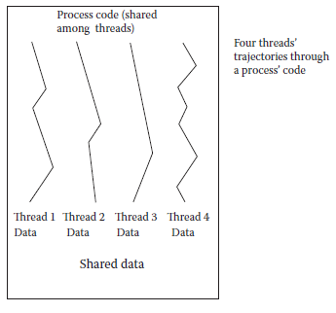
Threads & Multithreading
Multithreading is multitasking across both processes and threads
Switching between threads is simpler (less time consuming)
Threads – multiple instances of the same process sharing the same code
But with separate data
For instance, you might have 3 Firefox windows open, these are threads of the same process
Threads make their way through the same code along different paths
See figure to the right

Slide 25
Process Management and Scheduling
25/64
Process – a running program
Processes have a status (running, ready, waiting, stopped)
And data (stored in memory, cache, registers)
Process management is how the OS handles the tasks of
starting processes, managing running processes, performing interprocess communication, terminating processes
Another aspect is process scheduling – selecting the next process to run
Scheduling algorithms include
round robin, priority, first come first serve, shortest job first, longest job first
CPU as a Resource

Slide 26
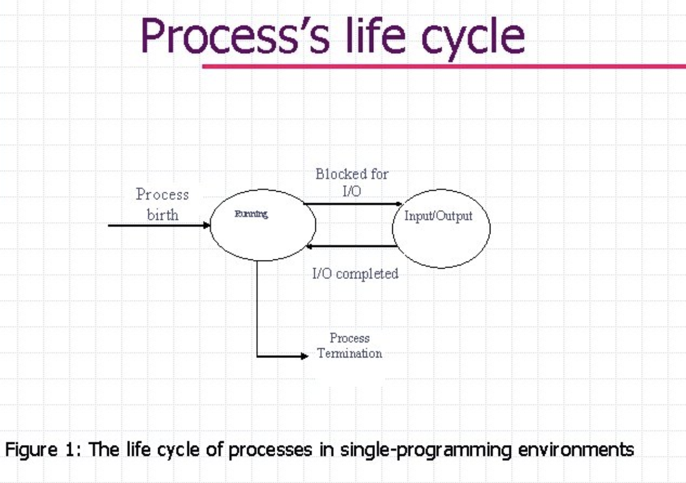
Single Tasking and Batch Processing
26/64
Single Tasking
User starts the process
Process runs to completion
If I/O is needed, CPU waits
User is not allowed to run more than 1 program at a time
Most early operating systems were single tasking
Most PC operating systems were single tasking until mid 90s

Slide 27
Single Tasking and Batch Processing
27/64
Single Tasking
User starts the process
Process runs to completion
If I/O is needed, CPU waits
User is not allowed to run more than 1 program at a time
Most early operating systems were single tasking
Most PC operating systems were single tasking until mid 90s
Batch Processing
For multiple user systems
users submit processes at any time
off-line system receives requests
OS schedules processes
Very similar to single tasking (one program at a time)
No interactivity because the process may not be executed until the user is gone
input supplied with the program (e.g., punch cards, magnetic tape)
output sent to off-line source (tape, printer)

Slide 28
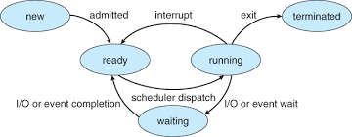
Operating system - multitasking
The computer can run several processes "simultaneously"
The CPU can only process one instruction from one process at a time (on each processor core)
The operating system must therefore keep track of which process is to use the CPU
CPU switching between processes is called context swiching
Process status:
Ready: Activated and waiting in line, in memory, but not currently executing by the CPU
Running: Running now
Blocked: Waiting to be activated,
Waiting queue – waiting to be loaded into memory
I/O queue – waiting for I/O to complete
We have a queue for processes with the same status
Notes:
Multi thread concurrency

Slide 29
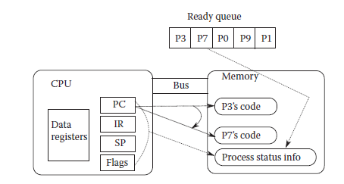
A Context Switch
Ready queue – stores those processes available for switching
These are processes loaded into memory which have either started execution and been paused or can start execution
Below, we see a switch between process P3 and P7
Concurrent processing needs a mechanism for the CPU to switch from one process to another
New process needs to be loaded into memory
Old process’ status (PC, IR, stack pointer, status flags, etc) saved to memory
New process status (register values) restored (from memory)
During the switch, the processor is idle

Slide 30
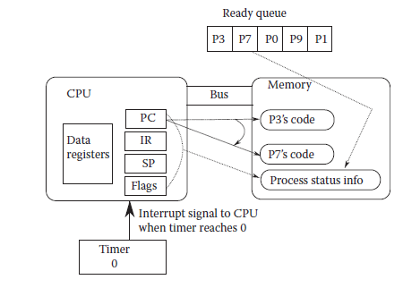
Multitasking
Computer appears to be executing two or more processes simultaneously
it is switching quickly between processes
Competitive multitasking was originally
called time sharing in the 1960s
Notes:
More appropriately called competitive (or pre-emptive) multitasking
Most OSs do both cooperative and competitive multitasking today

Slide 31
Multiprocessing
31/64
Many computers today have multiple processors
Or multiple cores on one chip (a core is basically a processor which shares pins and a cache with other cores on the same chip)
Multiprocessing is multitasking spread across multiple processors
Most OSs are capable of multiprocessing but do not necessarily share the cores effectively
For instance, if you have 4 cores, you would not achieve a 4 times speedup over a computer with a single core processor

Slide 32
Memory Management
32/64
We may not be able to fit all of our running program(s) in memory
We use swap space as “backing storage”
Swap space is placed on the hard disk
We break our programs into fixed sized units called pages
The OS moves pages for us between swap space and memory as needed (on demand)
This is known as virtual memory
Program broken into fixed sized pages
Memory broken into fixed sized frames
when process begins running, first pages are moved to available frames
OS maintains page table
CPU generates a memory address:
page #, position on page
Use page table to translate this to physical address
frame #, position on frame
If page not in memory, page fault occurs
Memory as a Resource

Slide 33
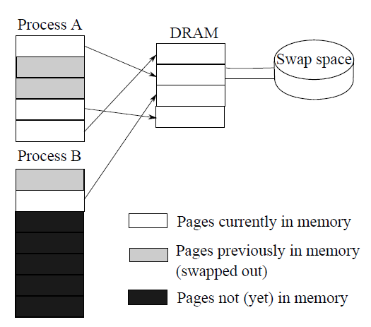
Virtual Memory: Paging and Page Tables
Process A page table
Process B page table
Valid means page in memory
Page | Frame | Valid
0 | 1 | T
1 | - | F
2 | - | F
3 | 3 | T
4 | 0 | T
Page | Frame | Valid
0 | - | F
1 | 2 | T
2 | - | F
3 | - | F
4 | - | F
5 | - | F
6 | - | F

Slide 34
Page Faults and Swapping
34/64
A page fault causes an interrupt
OS uses a replacement strategy to find frame to free
if frame is of a page that has been modified, the page has to be saved back to swap space
once a frame is free, new page is loaded from swap space into memory
page table updated
Movement of pages from swap space to memory (and memory to swap space) is swapping
swapping slows down the process because disk access time is much slower than memory access time

Slide 35
Resource Management
35/64
This is data corruption
The OS is also responsible for maintaining all other system resources
disk files, tape drives, flash drives
network access
printer access
Most resources require mutually exclusive access
no more than 1 process can access a device at a time, others must wait until device is free
Multitasking processes P0 & P1
P0 opens access to file F0
P0 reads datum X
P0 adds 10 to X
CPU switches to P1
P1 opens access to file F0
P1 reads datum X
P1 subtracts 300 from X
P1 writes new value to F0
CPU switches to P0
P0’s value of X is now incorrect

Slide 36
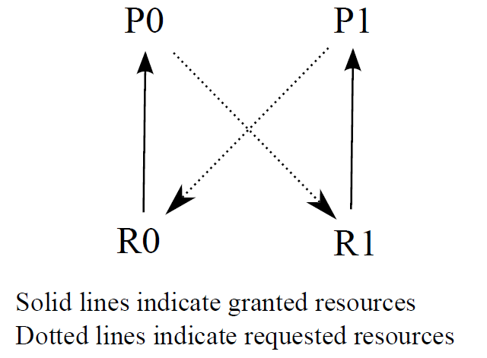
Deadlock - Resource Management
In the this scenario, P0 is using R0, P1 is using R1, P0 wants to access R1 and P1 wants to access R0
Deadlock
The result is that neither P0 nor P1 can continue
We would have to kill one of the processes to let the other continue (restart the killed process later)
OSs will often ignore deadlock and require that the user discover it and kill one of the processes off

Slide 37
Programmer perspective: The core ("KERNEL")
The kernel starts up and configures hardware
The core manages processes, threads and resources

Slide 38
User mode vs core mode
For security and protection, most CPUs provide the ability to run instructions in either application or kernel mode
Common applications and many OS services run in "user mode" (Intel / AMD "ring 3").
Unable to access HW, equipment drivers directly, must use an API.
Only access the memory allocated by the OS.
Limited instruction set
OS runs in core mode ("call 0")
Access to the entire memory
All instructions can be run

Slide 39
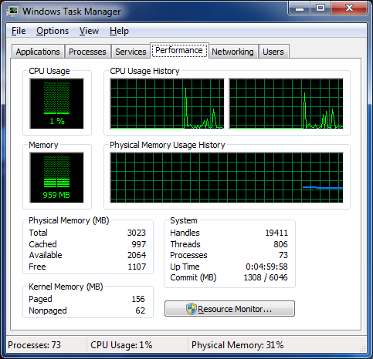
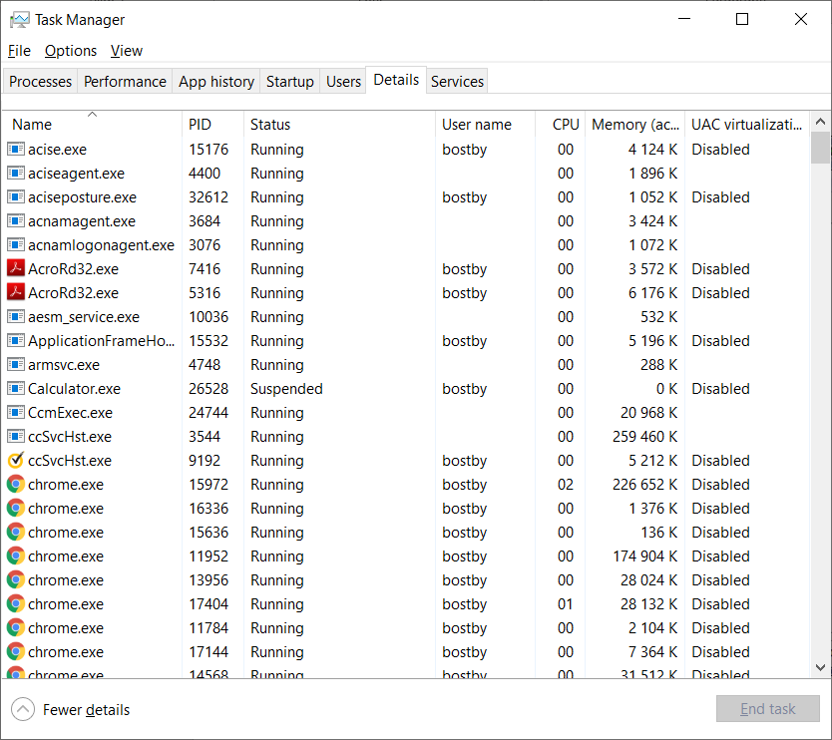
Processes and threads: Task manager
Windows - Task Manager
Ctrl-Shift-Esc
Lets you inspect processes and their use of resources

Slide 40
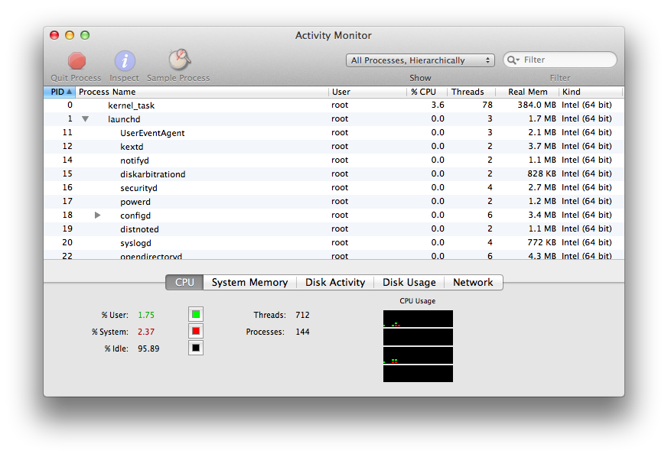
OSX – Activity Monitor
Displays (sorted) overviews of processes, threads, resources.
Can also use the bash tools…
Bash is a Unix shell and command language

Slide 41
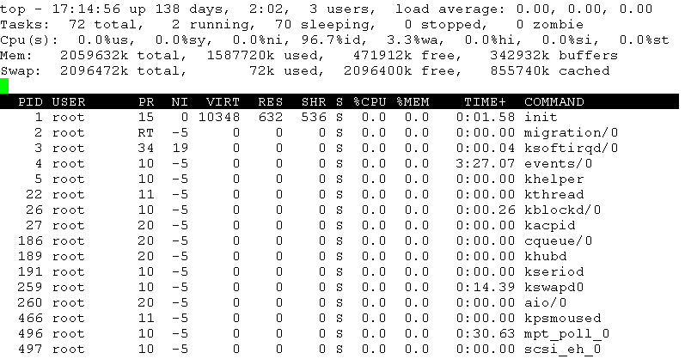
Linux: ps, top
Linux /OSX – ps, top og /proc
ps -- process status
top -- display sorted information about processes
/proc –«part of the "file system»

Slide 42
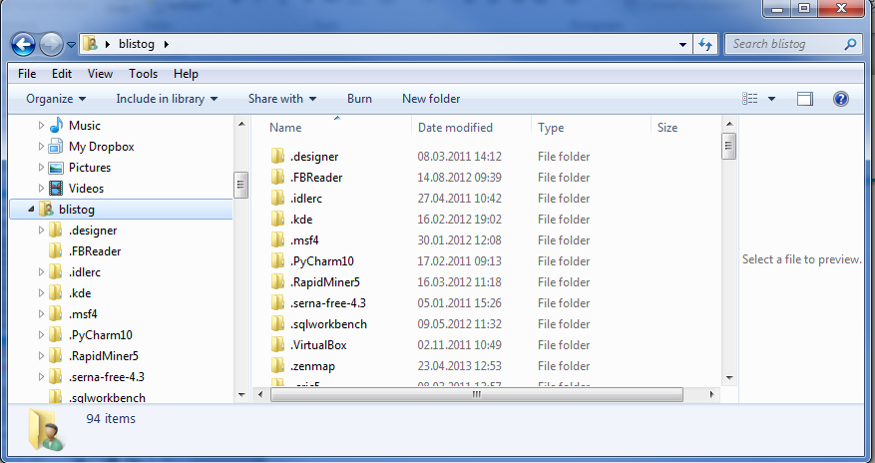
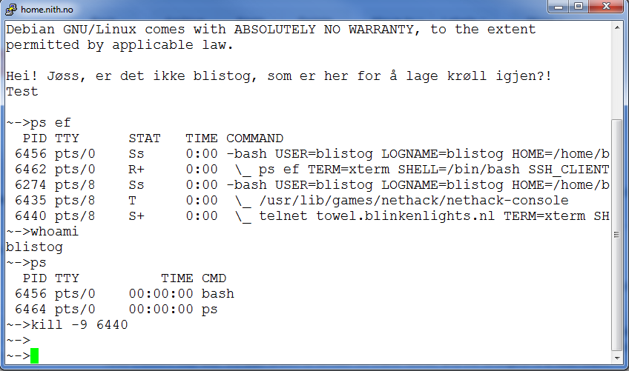
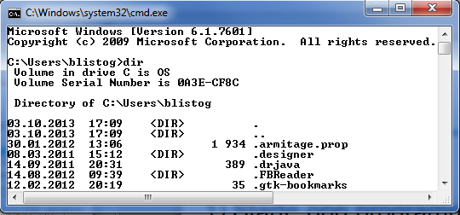
User perspective: THE SHELL
Most important in normal use: 1) Start up programs ("processes")
2) Maneuver around the file system

Slide 43
User Interface
GUI
Point and click, drag, double click
Touch screen devices use gesture-based motions (swiping, tapping, pinching, reverse pinching)
Command line
Enter commands from a command line prompt
Commands executed by an interpreter
breaks instructions into component parts
converts instructions to machine code and executes them
maintains a “session”
Commands may look cryptic and be hard to learn but offer more power and flexibility
Linux command: find ~ -name ‘core*’ –exec rm {} \;
Notes:
we examine the Bash interpreter in chapter 9

Slide 44
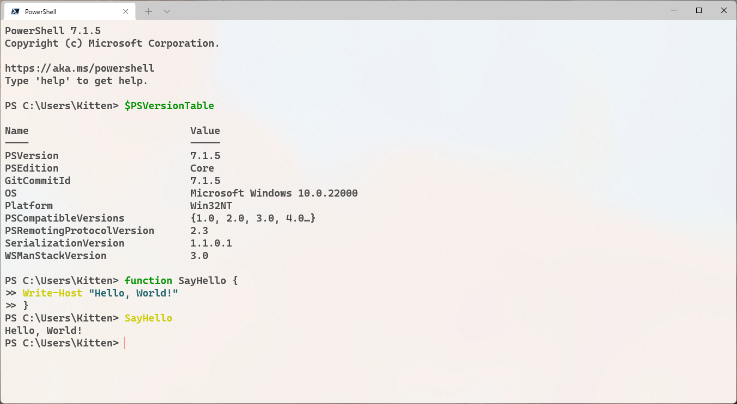
User perspective: The shell
The user can order the OS via the shell
Start up programs
Move files
Windows
Explorer (GUI)
Cmd.exe is the command line for Microsoft Windows operating system, with command-based features.
Powershell is a task-based command-line interface, specifically designed for system admins and is based on the Windows PowerShell is still present on the latest versions of Windows 11 and 10, but the latest versions of PowerShell are called PowerShell or Microsoft PowerShell.
Linux
Example: Nautilus (Gnome)
Nautilus, is the official file manager for the GNOME desktop
Bash . Net Framework. Bash is a command-line and scripting language for most Unix/Linux-based operating systems.
OS X
Finder (GUI)
bash
Notes:
CMD (NT)

Slide 45
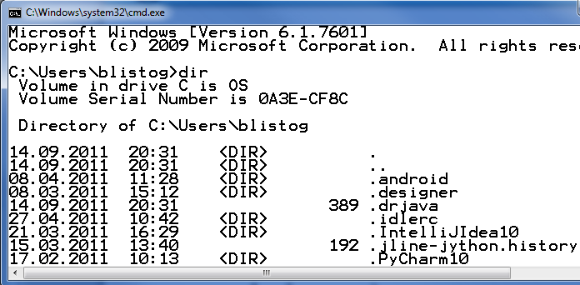
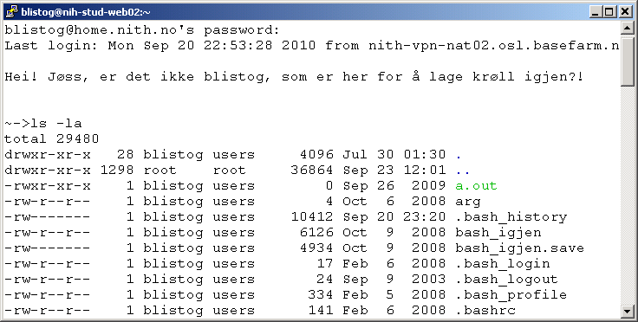
”DOS” (cmd.exe) – UNIX/OSX (bash)
Similarities.
Text and command based.
Hierarchical file structure.
File access (read, write, ...)
Standard I / O with piping (>, >>, <, |)

Slide 46
Commands CMD vs BASH
DOS UNIX
display list of files dir ls
display contents of file type cat
copy file copy cp
rename file ren mv
delete file del rm
delete directory rd rmdir
find string find grep
create directory md mkdir
change working directory cd cd
get help help man
print file print lpr
Change permissions attrib chmod

Slide 47
Commands and flags
How a command behavior can be modified by setting different flags.
placed directly or after a flag marker (/, -, --)
dir /? ls –la ps aux

Slide 48
Commands and redirection
Usually the output is to the monitor (console), but in addition you have some standard redirection operators.
>
Writes output into a file.
Ex:
dir > katalog.txt, or ls –la > directorylist
>>
Writes output at the end of a file.
<
Takes the contents of a file and uses it as arguments to the command.
|
Takes output from one command and delivers it as input to the next command.
Ex: dir | sort /R | more ps aux | grep blistog | wc
«pipe»

Slide 49
Signals
Under both Windows and Linux / OSX, you can in the CLI shell (command line interface) give signals to the OS with a few keyboard shortcuts.
Ctrl-C Abortion running process.
Ctrl-D End of file (EOF)
Ctrl-Z Put running process to sleep
Etc.

Slide 50
Why use command shell?
GUI is excellent for "point, drag, click" tasks.
Bad for e.g. automation due to poor semantics
Command shells usually offer a complete programming language (called batch / bash).
Servers
Most web server runs Apache on Linux, and is not set up with GUI as it would be poor resource use.
Microsoft has also started to focus more on shell than GUI for servers .. (Powershell)

Slide 51
File management

Slide 52
Operating system files
Data stored in a memory disappears when the power is turned off
Data can also be stored permanently
Disk, floppy disk, CD, tape, ......................
Such a repository consists of folders and files
Hierarchical structure
Name, access rights, creation date, ................

Slide 53
Abstraction
To abstract means to remove (insignificant) details.
For example: A file will (most often) consist of metadata (data about data)
A name
when created, last modified, o.l.
how big (KiB)
which sectors of the disk data is physically located on
... and the content itself (data / instructions)
The files are organized in directories (directories / folders))
another abstraction, which is also a type of file that contains metadata and addresses of other files.

Slide 54
File management as an OS Tasks
File management
Users dictate file system operations through windows explorer or command line instructions (DOS, Linux)
creating directories, moving files, copying files, deleting files, etc
Every file operation is a request
the OS must ensure that the user has access to the given resource to perform the operation
Protection
Resources need protection from misuse
Each resource has permissions associated with it (access, read, write, execute)
User accounts/authentication are used to establish protection
Security extends permissions across a network
A user can then remotely control the computer

Slide 55
File management
The file manager in the OS must:
Store information securely on equipment (storage device: hard disk,…).
Map the connection between block storage on the equipment and the file abstraction (logical "image")
Allocate / deallocate storage devices
Manage data sharing
Protect against errors, crashes and malicious users
Simultaneous control

Slide 56
Drivers
Drivers are software that can translate back and forth between OS requirements and the instruction set of the controller on the equipment.
The main cause of crashes is poorly written drivers
Microsoft claims "at least" 70%

Slide 57
Single and multiprocess Management

Slide 58
Forms of Process Management
Can the OS run more than one program at any time?
not simultaneously but concurrently
One process at a time
single tasking
batch processing
Concurrent processing
multiprogramming
multitasking
multithreading
multiprocessing
https://slidetodoc.com/operating-systems-lecture-3-multiprogramming-multithreading-multiprocessing-and/

Slide 59
Single Tasking and Batch Processing
Single Tasking
User starts the process
Process runs to completion
If I/O is needed, CPU waits
User is not allowed to run more than 1 program at a time
Most early operating systems were single tasking
Most PC operating systems were single tasking until mid 90s
Batch Processing
For multiple user systems
users submit processes at any time
off-line system receives requests
OS schedules processes
Very similar to single tasking (one program at a time)
No interactivity because the process may not be executed until the user is gone
input supplied with the program (e.g., punch cards, magnetic tape)
output sent to off-line source (tape, printer)

Slide 60
A Context Switch
Ready queue – stores those processes available for switching
These are processes loaded into memory which have either started execution and been paused or can start execution
Below, we see a switch between process P3 and P7
Concurrent processing needs a mechanism for the CPU to switch from one process to another
New process needs to be loaded into memory
Old process’ status (PC, IR, stack pointer, status flags, etc) saved to memory
New process status (register values) restored (from memory)
During the switch, the processor is idle

Slide 61
Multiprogramming & Multitasking
Multiprogramming (or cooperative multitasking) is like batch processing in that one process is executed at a time except
When a process requires I/O, it is moved to an I/O queue
Context switch to next waiting process
When process finishes with I/O, switch back to it
More efficient than batch processing or single tasking because the CPU does not remain idel during time consuming I/O, only delay is during the context switches
For multitasking, add a timer and before a process starts, set the timer to some value (e.g., 10,000)
After each machine cycle, decrement the timer
When timer reaches 0, force a context switch to the next process in the ready queue
User will not notice the time it takes to cycle through the processes

Slide 62
Multitasking
More appropriately called competitive (or pre-emptive) multitasking
Computer appears to be executing two or more processes simultaneously
it is switching quickly between processes
Most OSs do both cooperative and competitive multitasking today
Competitive multitasking was originally
called time sharing in the 1960s

Slide 63
Threads & Multithreading
Multithreading is multitasking across both processes and threads
Switching between threads is simpler (less time consuming)
Threads – multiple instances of the same process sharing the same code
But with separate data
For instance, you might have 3 Firefox windows open, these are threads of the same process
Threads make their way through the same code along different paths
See figure to the right

Slide 64
Multiprocessing
Many computers today have multiple processors
Or multiple cores on one chip (a core is basically a processor which shares pins and a cache with other cores on the same chip)
Multiprocessing is multitasking spread across multiple processors
Most OSs are capable of multiprocessing but do not necessarily share the cores effectively
For instance, if you have 4 cores, you would not achieve a 4 times speedup over a computer with a single core processor

Slide 66
Interrupts
The CPU’s fetch-execute cycle runs continuously unless interrupted
Interruptions can come from hardware or the running program
control+alt+delete
mouse moved
printer out of paper
program has run-time error
An interrupt interrupts the CPU at the end of fetch-execute cycle
Upon interrupt, CPU determines what device (or user or software) raised interrupt
select the proper interrupt handler (piece of OS code)
execute interrupt handler to handle the interrupt
resume the interrupted process

Slide 67
Operating system - memory
Programs that are running are in memory
The operating system is also a program!
Regular RAM is enhanced in several ways
Cache is a very fast memory (SRAM)
Used both between CPU and RAM and for some devices
If the RAM is too small, some of the contents may be temporarily swapped.

Slide 68
Schedule
The OS uses a roadmap to determine which thread should be allowed to run on the processor
Context switching takes time
There are two roadmap principles
Non-preemptive
the CPU is allocated to the process till it terminates or switches to waiting state.
Preemptive
the CPU is allocated to the processes for the limited time.
A clock-controlled interruption periodically ensures that the thread that is running is set to ready
The power method
NT, OSX and Linux have preemptive schedules based on priority queues and the Round Robin algorithm

Slide 69
Different types of executable files
Different OSes use different formats for executable program files.
binary executable file formats which, once loaded by a suitable executable loader, can be directly executed by the CPU rather than being interpreted by software.
Windows: Portable Executable (PE)
The Portable Executable (PE) format is a file format for executables, object code, DLLs and others used in 32-bit and 64-bit versions of Windows operating systems.
Linux: ELF
In computing, the Executable and Linkable Format^{[2]} (ELF, formerly named Extensible Linking Format), is a common standard file format for executable files, object code, shared libraries.
OSX: Mach-O
They also use different system calls and standard libraries

Slide 70
The process (thread)'s Memory
On the Intel architecture, a task partitions its assigned memory
..
TEXT (code) segment
Read from program file for example by exec
usually read-only
Can be shared by several threads
DATA segment
initialized global variables (0 / NULL)
uninitialized global variables
heap
dynamic memory for example, allocated with malloc
growing upwards
STACK segment
Variables in a function
Stored registry states (calling function EIP)
Grows downwards
system data segment(PCB)
segment pointers
pid
program and stack pointers.
…
Multiple stacks for the threads
low addresse
system data segment (PCB)
8048314 <add>:
8048314: push %ebp
8048315: mov %esp,%ebp
8048317: mov 0xc(%ebp),%eax
804831a: add 0x8(%ebp),%eax
804831d: pop %ebp
804831e: ret
804831f <main>:
804831f: push %ebp
8048320: mov %esp,%ebp
8048322: sub $0x18,%esp
8048325: and $0xfffffff0,%esp
8048328: mov $0x0,%eax
804832d: sub %eax,%esp
804832f: movl $0x0,0xfffffffc(%ebp)
8048336: movl $0x2,0x4(%esp,1)
804833e: movl $0x4,(%esp,1)
8048345: call 8048314 <add>
804834a: mov %eax,0xfffffffc(%ebp)
804834d: leave
804834e: ret
804834f: nop
…
...
…
…
code segment
initialized variables
uninitialized variables
data segment
data segment
process A
heap
“unused” memory
stack
possible stacks
for more threads
high addresse

Slide 71
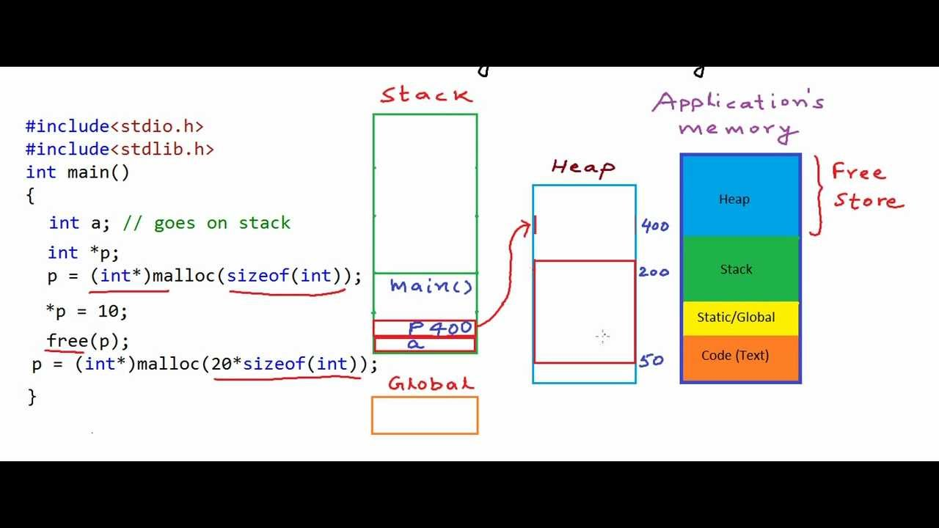

Slide 72
HISTORY
Hardware has controlled what the OS offers / does;
New hardware has often been added based on OS needs.
(Not necessary, but exciting and useful to have been through)

Slide 73
Operating system - early development
Until the 1960s, there was no need for an operating system. The computer was used by one person or one job at a time
When batch running, the machine had to have a queue organizer
When time-sharing (multitasking), the machine had to keep track of several processes at once
The use of mass storage required an organized file system
Virtual memory required better control of the file system
Constantly new external equipment required simplified I / O control
Users were computer people

Slide 74
Operating system - further development
Complicated start-up procedure
Multiple interactive users on the same machine
Need for general service programs for users
Networking machines
Protect machines and users from machines and users
PCs underwent the same development as larger machines already had
Increasing supply of applications on machines and online
The weight of users without a data background

Slide 75
Specialized operating systems
Parallel systems.
More than one CPU in the same machine
Can run multiple jobs simultaneously.
Distributed systems.
Several machines work together
Sharing jobs and resources.
Real-time systems.
Time-critical response time, controlled by interrupt.
Network
Mobile phones and the like

Slide 76
Operating systems
UNIX
Written in C (1971), text-based, portable, multi-user
Linux as a modern (PC) version
Great degree of freedom both advantage and disadvantage.
MS-DOS
Written in machine code (1980) by Microsoft for IBM
Text-based, single-user
Later built Windows 3.0-11 GUI achieve DOS
Small degree of freedom

Slide 77
DOS
DOS taken a lot from UNIX and may therefore seem to be relatively similar.
CP / M: Gary Kildall, 1973 for 8080 and 8 ”disk (DR-DOS)
86-DOS: Tim Paterson, 1980 for 8086.
FAT file system
MS-DOS: Microsoft for IBM, 1981, based on 86-DOS that they bought for $ 75,000.
The main difference doest not apply so much in the commands but in freedom, structure and portability

Slide 78
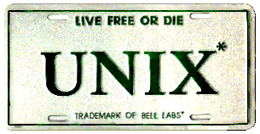
DOS - UNIX
Differences.
DOS was single-user, UNIX was multi-user
DOS only supports single-processing, UNIX supports multi-processing
DOS had command interpreters (command.com -> cmd.exe), UNIX uses shell (bash, bash, csh, tcsh, ...)
DOS / NT runs on Intel compatible processors, UNIX is much more portable
DOS / NT used bat and cmd files, UNIX uses shell scripts

Slide 79
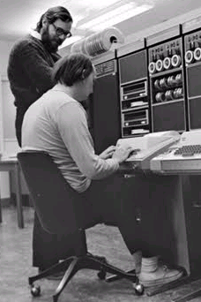
UNIX history
Started as Multics at MIT 1965.
First time-sharing OS.
Further developed at Bell 1965-1969.
Ken Thompson, Dennis Ritchie, ,.......
Transferred from PDP-7 to PDP-11 1970
Unics → Unix
Written in C
Formed basis for portability.
Linux - Linus Torvalds 1991
Simplified time map!

Slide 80
MULTI-TASKING
All modern OSs offer multitasking
Multiple processes run "simultaneously",
"Simultaneously" means that they are allocated time on the CPU to run their thread (s)
or run on separate processor cores
Sync issues
OS provides scheduling
OS provides memory isolation and collaboration between processes / threads

Slide 81

Microsoft Windows
Windows 1.0, 2.0, 3.0 and 3.1 are graphical interfaces for DOS
Windows 95/98 includes DOS as a service
Windows NT was a more portable version of Windows
New core design from scratch. Not based on DOS
Modular, 32 bit system for many simultaneous environments
Robust mechanisms for critical processes
Runs all Windows applications with the same interface
In Windows XP, Windows 98 and Windows 2000 met
Vista adds new security model and interface
Windows 7 and Server 2008 are still the same kernel (NT)
Windows 8 and 10 are the next step, but involve no / small changes in the kernel (Windows Vista is internally «Windows 6.0», Windows 10 is internally «Windows 6.3»…)

Slide 82
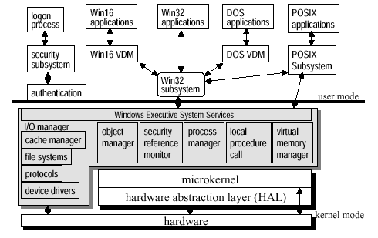
Windows
System structure

Slide 83
Windows
Registry
Centralized database for system configuration information
Continuation of DOS and Windows INI files
Used by various Win devices
Recognizer: Recognizes hardware at startup
Setup: System configuration tool
Kernel: CPU configuration and system load balancing
Drivers: Hardware initialization information

Slide 84
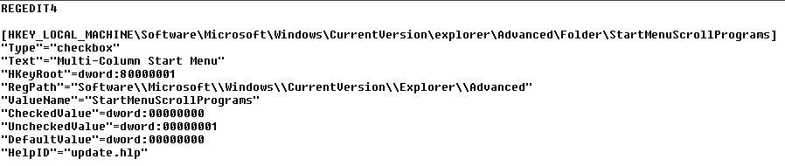
Windows
Registry
Hierarchical structure
HKEY_ LOCAL_MACHINE
HKEY_ CLASSES_ROOT
HKEY_ CURRENT_USER
HKEY_ USERS
HKEY_ CURRENT_CONFIG
HKEY_DYN_DATA
Updates are not validated against other parts of the registry
Backup and restore are sensitive

Slide 85
Windows
NT File System (NTFS)
Great improvement over DOS 'FAT
Better features and performance
Data recovery, security, large files, compression
Metadata stored in Master File Table (MFT)
Data about data: How, when, by whom and formatting
NTFS is not just byte streams
MFT contains information about the data
File references are more than just addresses
48 bit file number (pointer), 16 bit sequence number (multidisc)
Logging of transactions
NTFS is not further developed and is waiting for an heir

Slide 86
OSX (prehistory)
Apple also started with a "clean" DOS (Disk Operating System) 1976-1984.
Non-multitask, 1-level file system ("without directories").
MacIntosh introduced in 1984
Finds as GUI «shell»
New file system after each : Hierarchical File System
Toolbox for GUI app development

Slide 87
OSX
Further development of NeXTSTEP.
Based on Mach micro core, FreeBSD (Unix) and I / O Kit driver package
The kernel is called Darwin / XNU (X is Not Unix)
Lots of Open Source thanks to the FreeBSD background

Slide 88
Summary

Slide 89
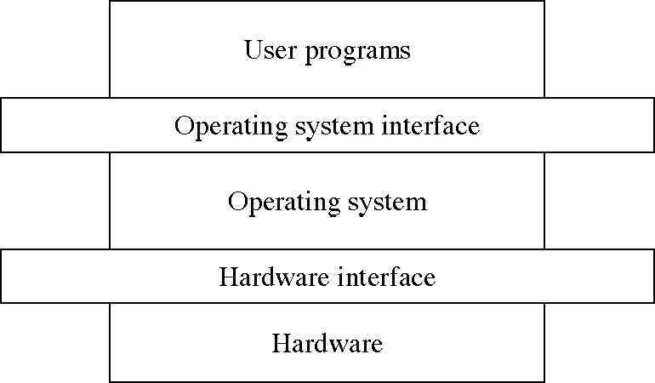
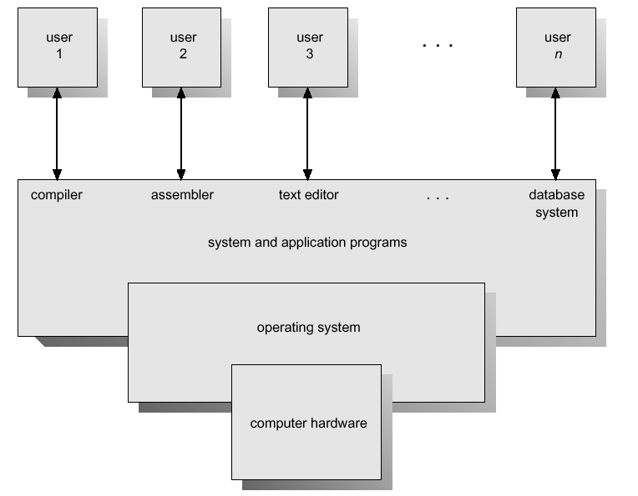
Operating system - general requirements
The operating system must therefore organize the available resources and manage them in the best possible way for both machines and users
Users will concentrate on applications without thinking about the machines' software and hardware ingenuity
Users will preferably be introduced to an environment that is independent of existing hardware
The training threshold should preferably be as low as possible

Slide 90
What should we know?
Define process, thread and resource.
Explain how OS abstracts Hardware and thus offers a simpler programming and user interface.
Be able to explain the OS's role as resource administrator: Process / thread-adm, Memory-adm, File-adm, Equipment-adm.
Know what problems need to be solved to get multitasking
Know the memory layout and running pattern of a regular program on an Intel-type processor.
Explain the difference between User and Kernel mode on CPU

Slide 91
EXERCISE
Advanced operating system operations
TK1100_F05_Ø05_OS_Advanced.pdf
Archive files; ZIP, TAR.GZ, encrypted archives.
Install software (.MSI / .EXE on Windows, .DMG on Mac, TAR.GZ on Linux)
Use CMD (shell) in operating system
Set aside several hours for these exercises, and USE the tutors, for most people this is more advanced PC use than you are used to - and practical tasks for the rest of the semester are based on this!
Practical assignments come to the exam
TK1102_F05_OS_Øvingsoppgaver.pdf

Slide 92
For optional self-study
For those who want to learn some topics more in depth to better understand, here are some extra topics related to today's teaching, it must be expected some personal work to understand these topics.
There will be no questions on the exam from these, and this is therefore not considered to be part of the syllabus.

Slide 93
PC system organization
Basic IBM PC from 1982
Mac used to have their own path, but had to change when they switched to Intel.
Some PC systems still boot into 16 bit mode.
max 1 MiB RAM
limited instruction set and memory model
only BIOS routines / interrupt.
Goes to 32/64 bit only when the OS is loaded.
More and more systems are now UEFI; but backward compatibility is taken care of.
Intel (x86) and AMD
Constructs and produses CPU, chipset etc.
Focus: Desktop, server, mobile, embedded.
Complex Instruction Set Computing
MIPS and ARM (apple)
Constructs and licenses CPU cores etc. to various manufacturers
Focus: Embedded, mobile
Reduced Instruction Set Computing
Now x86 and ARM processors bothe have features of RISC and CISC
What is the boot process?

Slide 94
Abstraction
To abstract means to remove (insignificant) details.
For example: A file will (most often) consist of metadata (data about data)
A name
when created, last modified, o.l.
how big (KiB)
which sectors of the disk data is physically located on
... and the content itself (data / instructions)
The files are organized in directories (directories / folders))
another abstraction, which is also a type of file that contains metadata and addresses of other files.
Physically / specifically, it is the only magnetized areas in addressed sectors on a disk / CD / memory stick
To the user, this abstraction appears as symbols h @ n can click on.
For the programmer, OS offers system calls that allow h @ n to create, open, close, position itself within, read from / write to

Slide 95
System call
Eksempel fra Linux:
sys_acct(const char *name)
sys_acct(const char * filename)
sys_capget(cap_user_header_t header, cap_user_data_t dataptr)
sys_capset(cap_user_header_t header, const cap_user_data_t data)
sys_exit(int error_code)
sys_wait4(pid_t pid,unsigned int * stat_addr, int options, struct rusage * ru)
sys_waitpid(pid_t pid,unsigned int * stat_addr, int options)
sys_futex(void *uaddr, int op, int val, struct timespec *utime)
sys_sysinfo(struct sysinfo *info)
sys_getitimer(int which, struct itimerval *value)
sys_setitimer(int which, struct itimerval *value,
sys_sync(void); /* it's really int */
sys_syslog(int type, char * buf, int len)
sys_nice(int increment)
sys_sched_setscheduler(pid_t pid, int policy,
sys_sched_setparam(pid_t pid, struct sched_param *param)
sys_sched_getscheduler(pid_t pid)
sys_sched_getparam(pid_t pid, struct sched_param *param)
sys_sched_setaffinity(pid_t pid, unsigned int len,
sys_sched_getaffinity(pid_t pid, unsigned int len,
sys_sched_yield(void)
sys_sched_get_priority_max(int policy)
sys_sched_get_priority_min(int policy)
sys_sched_rr_get_interval(pid_t pid, struct timespec *interval)
sys_ni_syscall(void)
sys_setpriority(int which, int who, int niceval)
sys_getpriority(int which, int who)
sys_reboot(int magic1, int magic2, unsigned int cmd, void * arg)
sys_setregid(gid_t rgid, gid_t egid)
sys_setgid(gid_t gid)
sys_setreuid(uid_t ruid, uid_t euid)
sys_setuid(uid_t uid)
sys_setresuid(uid_t ruid, uid_t euid, uid_t suid)
sys_getresuid(uid_t *ruid, uid_t *euid, uid_t *suid)
sys_setresgid(gid_t rgid, gid_t egid, gid_t sgid)
sys_getresgid(gid_t *rgid, gid_t *egid, gid_t *sgid)
sys_setfsuid(uid_t uid)
sys_setfsgid(gid_t gid)
sys_times(struct tms * tbuf)
sys_setpgid(pid_t pid, pid_t pgid)
sys_getpgid(pid_t pid)
sys_getpgrp(void)
sys_getsid(pid_t pid)
sys_setsid(void)
sys_getgroups(int gidsetsize, gid_t *grouplist)
sys_setgroups(int gidsetsize, gid_t *grouplist)
sys_newuname(struct new_utsname * name)
sys_sethostname(char *name, int len)
sys_gethostname(char *name, int len)
sys_setdomainname(char *name, int len)
sys_getrlimit(unsigned int resource, struct rlimit *rlim)
sys_old_getrlimit(unsigned int resource, struct rlimit *rlim)
sys_setrlimit(unsigned int resource, struct rlimit *rlim)
sys_getrusage(int who, struct rusage *ru)
sys_umask(int mask)
The interface between the OS and the users is defined by a number of system calls.
Performing a system call is similar to a regular method call, but the system call runs kernel code:
application
application
application
USER MODE
CORE MODE
system call interface
OS komponenter

Slide 96

Process created (Unix) - fork ()
Prosess 1
Prosess 2
right after fork ()
after termination
(or at any time)
rett etter fork()
Protocol control block (process descriptor)
PID
address space (text, data, stack)
state
allocated resources
…
make_sandwitch()
make_burger()
make_small_cake()
fork()
make_coffee()
make_big_cake()
buy_champagne()

Slide 97
Virtual memory
= paging and swapping
The program is run instruction by instruction
Not all instructions need to be present in memory, only those to be run
Abstract the memory usage!
The program itself thinks it has all the memory (all the addresses) available.
The program is compiled with internal (logical) memory addresses…
The program is divided into pages that are only loaded into memory if the address the page contains is referenced..
Reference to a page that is not loaded in memory triggers a PAGE FAULT.
CPU has a MMU (Memory Management Unit) that translates between program internal (logical) addresses and actual physical addresses in RAM (page table)
If the memory becomes too full, memory pages can be displayed on disk (swapping).

Slide 98
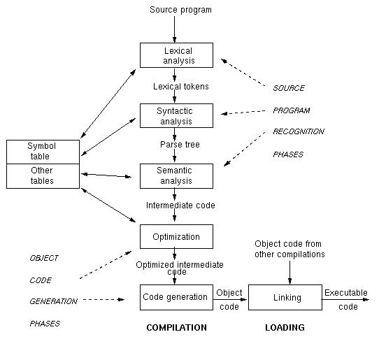
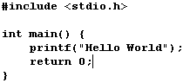
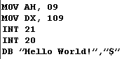

Compilation
i C
Assembly

Slide 99
LEVELS for safety and measures
Data
Access Control Lists, encryption (of file systems), …
Application
Patching, Certificates, Anti-virus,…
Host machine
OS, authentication and authorization, useradm, group policies…..
LAN (Internal nett)
IP-segmentering, IPSec, IDS, …
Boundary (Perimeter)
IDS, Firewall, VPN, NAT, …
Physical security.
Guard, locks and surveillance.
Policy, procedures, awareness.
User training
Integrity
Information security
Confidiality
Availiability

Slide 100
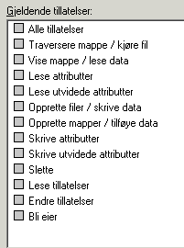
Security and file system
Both Linux / OSX and Windows use different types of ACL (Access Control List).
Linux file systems share access rights(execute, read, write) based on the grouping
user
group
all
Directories (d) are just a special type of user
Only the user root has all rights / is administrator
Windows (NTFS) has a more fine-grained and complicated system.
Regular users are often set up as administrators as well

Slide 101
Operating system - I / O control
All equipment connected to the computer is perceived as a resource by the operating system
Screen, keyboard, mouse, CD, speakers, .............
The operating system must know how the computer will communicate with all the equipment (drivers)
Plug and play
The operating system must present the equipment in a simple and straightforward manner, also for programming.
UNIX / Linux: "Pretend" everything is files that can be read / written to. (loadable modules)
Windows: "Pretend" everything is objects. (complicated object space, many levels of drivers)

Slide 102



Interrupt (og Exception) Handling
The IA-32 architecture has an IDT with pointers to 256 different interrupts and exceptions
32 (0 - 31) predefined and reserved
224 (32 - 255) user / OS defined
Each interrupt has a pointer in the Interrupt table (IDT) and a unique index value that provides handling as follows
process running, there comes an interupt
maintain driving condition, transfer control and find interrupt handling routine
Execute interrupt handling
retrieve aborted process
continue execution
user
kernel
disk interrupt (x)
IDT:
Interrupt routines:

